Slide 1
PBRC #2 (Path to Higher Consciousness)
Total Healing; Mind, Body & Soul

Slide 2
Introduction & Overview
House Keeping & Upcoming Events in OKC
Paladinic Healing
  50% offer Ends Feb. 29th, book up until then
  www.PaladinicHealing.com

Slide 3





Connect with us
Like Us on:
https://www.facebook.com/PaladinicHealingbyRebeccaRiggs
https://twitter.com/Rebecca_J_Riggs
http://www.meetup.com/Advanced-Healing-Psychic-Development-Group/
www.PaladinicHealing.com
mailto:RebeccaRiggs@PaladinicHealing.com
Please share your experience with us

Slide 4
Upcoming Classes
PBRC #1 – 6:30 pm
  2/29 – Conscious Wellness (Edmond)
PBRC #2 - 6:30 pm
  2/24 – Conscious Wellness (Edmond)
  3/5 – UU Church (Stillwater)
  3/28 – Conscious Wellness (Edmond)
PBRC #3 – 6:30 pm
  3/14 – Radiant Living (OKC)
Healing & Technique Group 6:30 pm
  Every Thursday (Edmond)
Check website & Meetup for additional dates and times

Slide 5

Path to Higher Consciousness Series
The Process
  Connect with Source (#1)
  Complete Healing (#2)
  Total Block Removal –Astral/Ethereal Travel (#3)
What is the goal of this Series
  To raise consciousness, vibrational levels, healing
Why this Series
To create a pathway to enlightenment, higher consciousness that is faster and more complete
What to expect during this Series
  Instant Healing, Shift in Consciousness, Happier thoughts and feelings, Deeper Sense of Knowing, Knowledge, Heightened Psychic Abilities

Slide 6
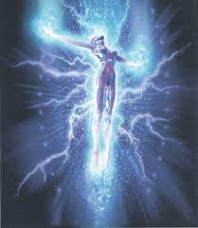
Ascending Higher
What is Ascension?
Why should we Ascend?
What are the symptoms?
  Changes in body temperature, nausea, increase growth of hair and nails, insomnia, visions, increased sense of knowing, intense feelings, etc.
Descending Back
  Putting the blocks/caps back on
  Why didn’t I hear or feel anything during the meditation
Ascension Symptoms
www.Ascensionsymptoms.com

Slide 7
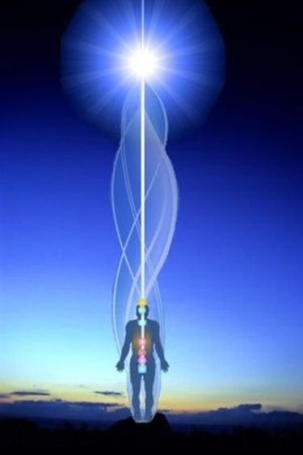
Recap from Series #1
The Silver Cord
  Can not be removed
  Can be moved around the body
  Connection to Source/God
  Used to Astral/Ethereal Travel
  Used to find others in all dimensions
  Is part of the Ethereal body

Slide 8
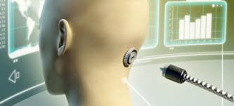
The Earth/Psychic Cord
  Connected to the back of the neck with one main connection and smaller ones on the sides
  This connection is comprised of earth/psychic energy
  Can be removed permanently or temporarily
  Is extremely different in look, feel and shape for each person
  Must be removed to Ascend to Higher Realms and to heal
Notes:
- The caps are put in place to keep in the material world. If you start removing caps then the material world with start to dissipate.

Slide 9
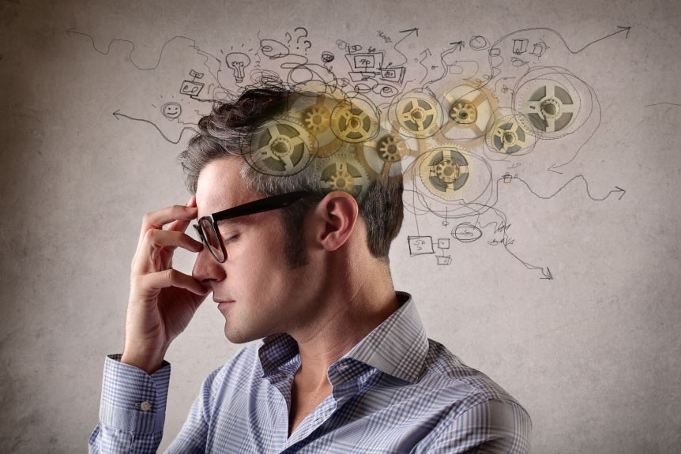
Thought Control
Thought
Energy
Matter
EVERYTHING stems from a thought
  You created your entire world, from your perspective
    Thoughts, words, deeds
    What wall are you focused on
  Collective thought & consciousness

Slide 10
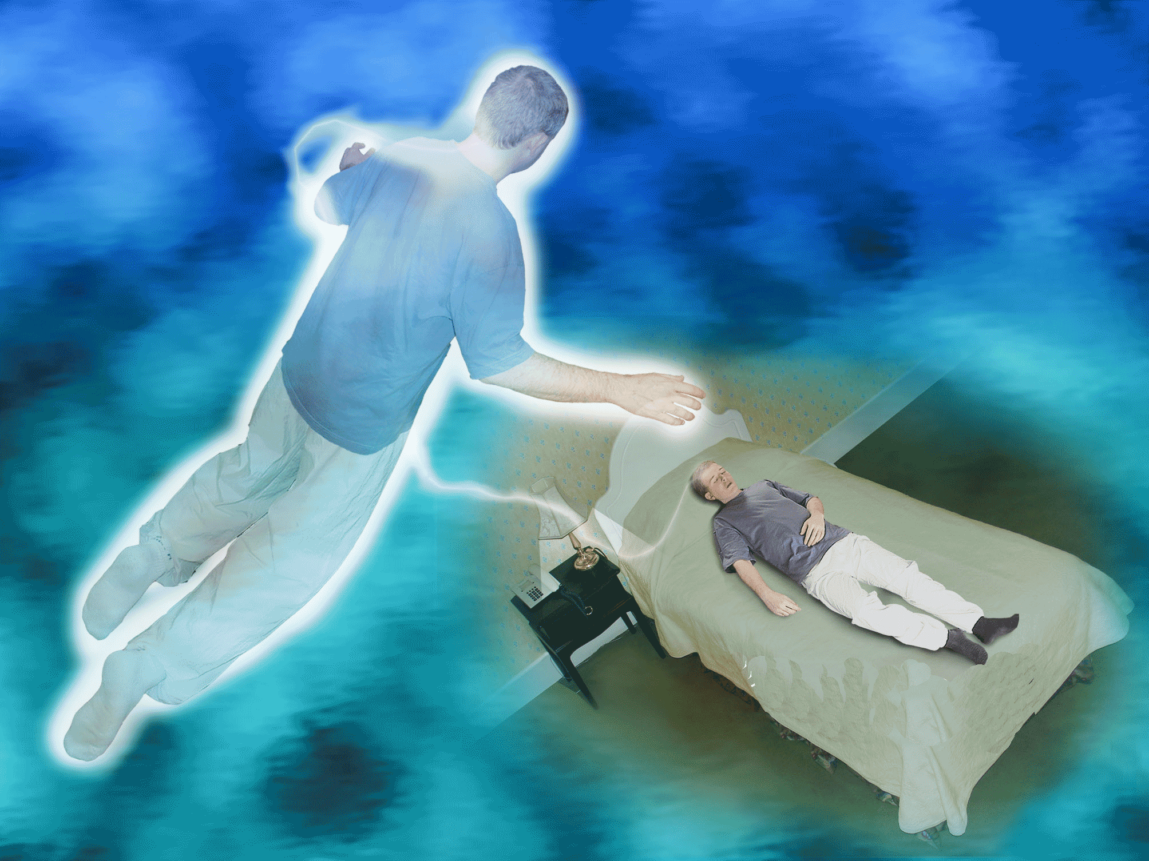
More about Thoughts
Thought is how you move while in the Astral and Ethereal Planes
Thought is not controlled by time and space
Thought is neither energy nor matter

Slide 11

Make Better Choices
Choosing, every moment of every day, how you will react – Free Will
  Accepting or denying beliefs
Controlling your thoughts
  Being consciously aware of your thoughts, words & deeds
  How can you do that?
    Exercises, meditations, practice, journaling, gratitude lists

Slide 12
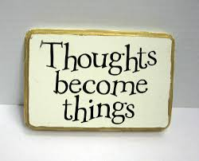
Energy
Thought -> Energy -> Matter
  What wall are you focuses on?
Everything is made of Energy,
  subatomic particles that vibrate and move at different speeds, thus creating matter
Everything you think is Real, is an illusion; a figment of your imagination
Your Vibration
  Where do you vibrate at?
  Why does your vibration matter?
    Clearing Low Energy, moving up the scale
Notes:
Don’t spend too much time on this slide, just a brief overview

Slide 13
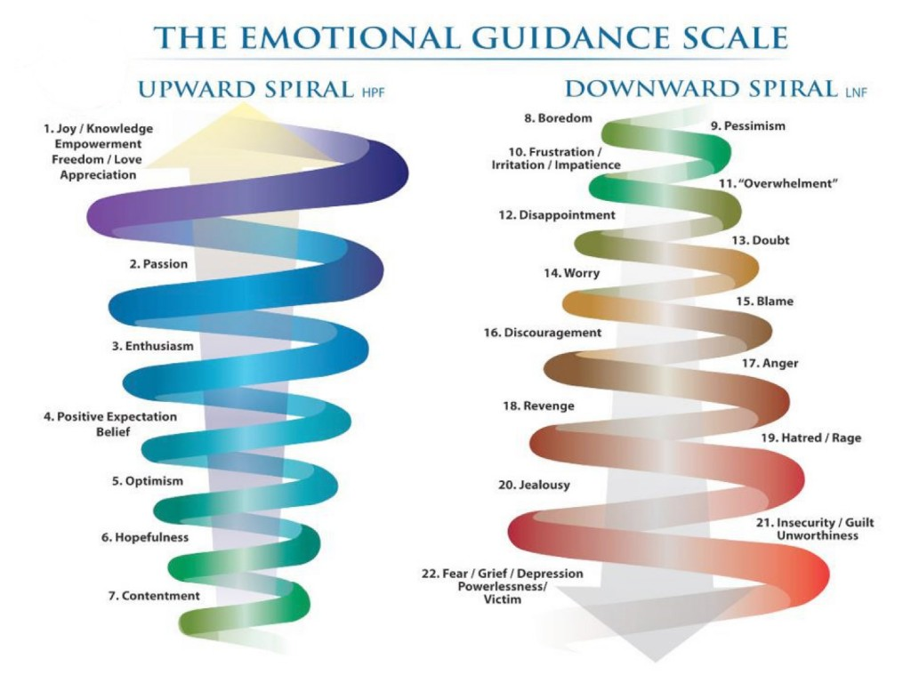
  Raising your Vibration

Slide 14
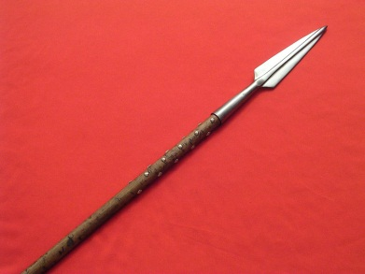
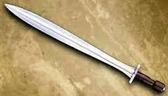
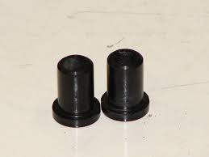
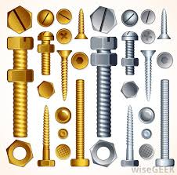
Energetic Blocks/Caps
What do they look like to you?
Where are they located on you?
Have you been able to take them off?
Ascend – Off
Descend – On
  Mortal mind will not remember most of the immortal
Notes:
- Located all over the body in the energetic field
Can not be seen by the normal human, but some advanced people can see them
They should not be removed without permission, permission from God/Higher Self
Removing these caps/blocks can have dramatic and debilitating effects on the person
Removing all of the caps/blocks at once will make the person go insane. There is a correct process and that process must be followed and permission must

Slide 15

PBRC #2 (Path to Higher Consciousness)
A deeper understanding of the energetic mind
Beliefs and Programs
The four levels of energetic attachments
Properly cutting attachments/Connections
Effects of Energy Clearing
The Healing Process
The Meditation

Slide 16
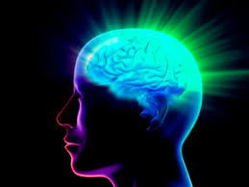
The Mind
Biological Super Computer
  Assessing information & Responding
  Pure Energy; Brain is a physical representation for the Mind
  Take it with you when you sleep/astral/ethereal travel
Conscious Mind
  A word Processor
  Decision maker for day-to-day activities
  What the conscious mind perceives as a belief isn’t exactly what your subconscious mind believes
  12% of the total mind
  Judges what is right and what is wrong

Slide 17
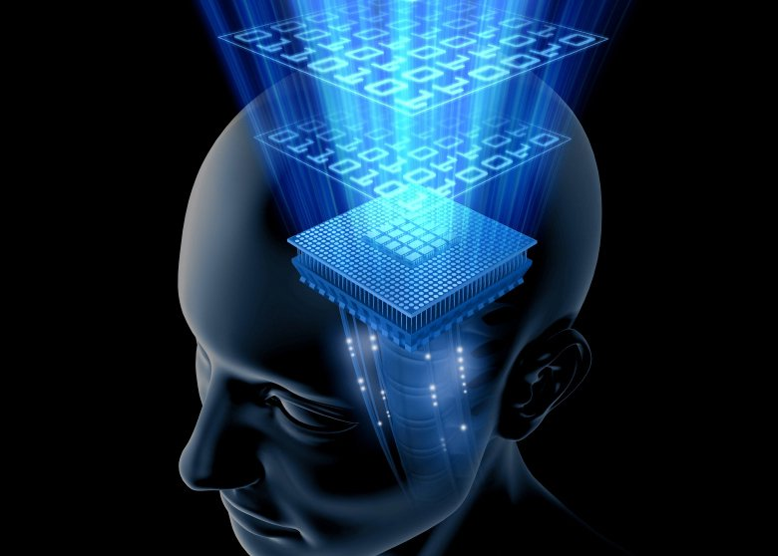
The Mind
Subconscious Mind
  Like the computer’s hard drive
  Contains memories, habits, beliefs, characteristics and self-image
  Stores information & performs tasks
  Bodily functions without thought; programmed to run
  88% of the total mind
  Changes must be made at this level
    Delete all Negative Thoughts & Thought Programs

Slide 18

The Mind
Super Conscious or God Mind
  Total Control of Everything
    Control of the Illusion
    Ability to manifest instantly, heal instantly, create & destroy instantly
    Astral/Ethereal Travel is God Mind
  In the Flow
  Controlled by Thought only
  Learn to bring it into your physical being
  Series #3!

Slide 19

Beliefs & Programs
Beliefs-Thoughts
  The acceptance by the mind that something is true or real, often underpinned by an emotional or spiritual sense of certainty
  From Society, family, teachers, friends, etc.
  You have the ability to CHOOSE to Accept or Deny
    Every moment of every day.
  Most difficult Belief/Program for Humans
    I am the creator of my life, all of it, every decision, every choice has been mine. I chose everything as an energetic spiritual being before I entered this body

Slide 20
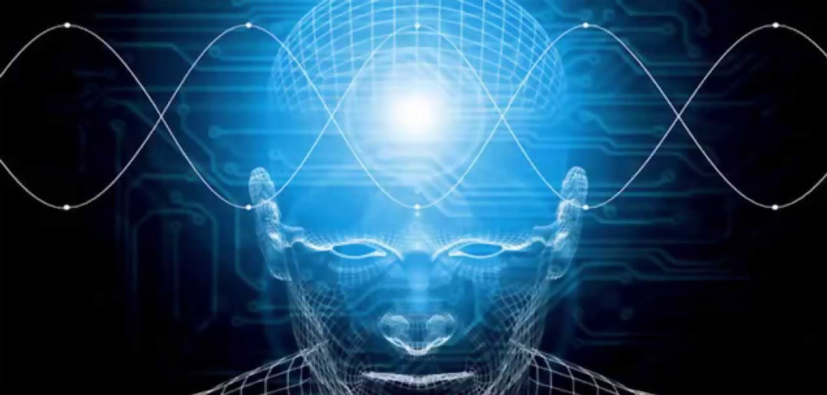
Programs
  A belief/thought that has been accepted by the body, mind, or soul
  Are stored in the subconscious mind
    Look Like files to me
  They override most things in the Conscious mind
    Example: Lack of money
  Must be removed on the subconscious level to properly work
    A continuous Process
    Getting into the weeds
  Free Will to override/recreate anything that has been reprogrammed
Reprogramming
  Adding in new programs/feelings when removing old programs/beliefs

Slide 21
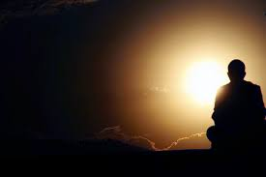
Healing Process
Prayer, Healing Assistance
Cut all connections, external & internal
  On all 4 Levels of Attachment
  Send back with Love & Light x3
  Energy Cleansing/Healing: Send the left over energy up to God/Source, Clean/Heal it, Transmute it & send it back down to you
Delete all Negative Thoughts & Thought Patterns, Negative emotions & emotional patterns
  On all 4 Levels of Attachment
  Repeat Energy Cleansing/Healing Process
Delete Lower Vibrational Emotions
Heal the Pineal Gland, DNA Healing
  Add Healing Seeds & Buttons with Flame Stamp

Slide 22
Healing Process Cont..
Soul Healing
Physical Body Healing
  Seeds/Zipper & Buttons
Chakra Healing
Aura Healing
Sending in the God Healing light in throughout the body, pushing out the rods/caps and sealing them up from head to toe
Healing Seeds/Zipper & Buttons over the entire body/Aura
Healing Blessing & Sealing

Slide 23

Effects of Energy Clearing
Detoxing, purging, physical effects
  Drainage, intensified feelings & emotions, aches & pains in the body, nausea, feeling sick or ill, increased body temperature, etc.
    Keep reaffirming health, stay positive as much as possible, get support from others, ask questions
      Understand, Accept & Choose Love
  Eat Healthier, Drink more water, Salt baths, exercise (Yoga), toxin releasing
  Moving Energy throughout the body
    Energy Fountain in the Body
  Continue the process
Turn down the symptoms
  Understand that’s its only an illusion; a figment of your imagination

Slide 24
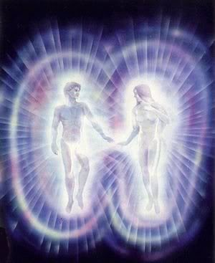
Energetic Levels of Attachment
The 4 levels
  Current Level
    Who you are today, in this life
    Can feel it all over the body
  Past Lives
    Feel the energy around the shoulders/neck area
  Soul/Spirit
    Feel it in the center of the body, the torso
  Genetics
    Feel it in the back of the neck/center of the head

Slide 25
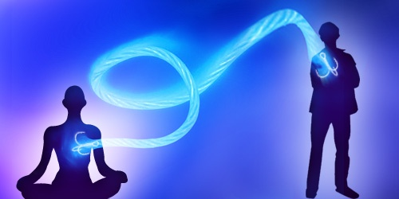
Cutting Connections
Cutting connections - on all levels of attachment
  What do these connections look like
  How they hold you back from ascending
  How to properly cut them
    Self-imposed & internal loops
    The energetic blender method
  Sending them back properly
  Repeating the process over & over again
  Getting to the root of the problem; into the deeper layers

Slide 26
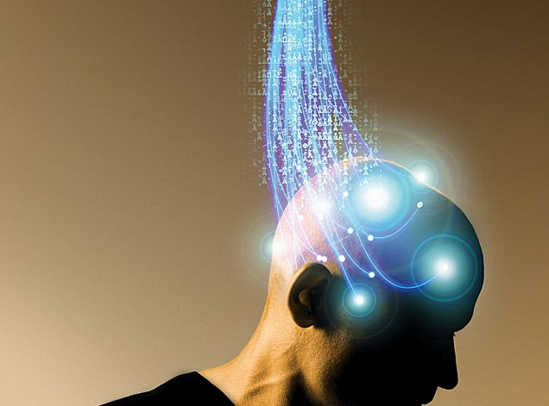
Deleting & Adding Programs to the Mind
Deleting Negative thoughts, thought patterns, emotions and emotional patterns
  Send them to God/Source to be healed/cleaned/purified
Adding New Programs
  The correct method; transmute
  The stamp of God
If you Delete a Program/Emotion, you must add a new one
Advanced Programming – Creating Master Programs
  Example; a Certain weight size

Slide 27
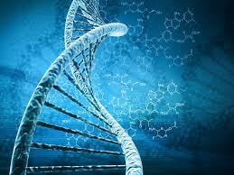
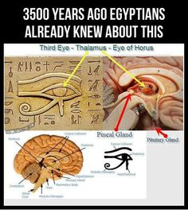
Healing the DNA
The Pineal Gland
  Size, Shape & Location
  Decalcifying the Gland
  Energy Field around the DNA
  2 strands of DNA
  Connection to the Psychic Earth Cord & Third Eye activation
  Remove ALL fluoride products from your diet
    Use a slice of lemon to remove toxins from your water
  Healing the Pineal Gland

Slide 28
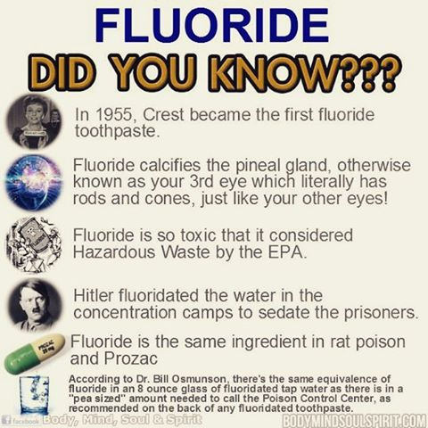
What year did our government start putting Fluoride in our water supply?
When you go to the dentist and they give you Fluoride in your mouth do you swallow it or spit it out? Why?
Study published in 2012 shows areas in China of High Fluoride levels lead to LOWER IQ’s in Children.

Slide 29
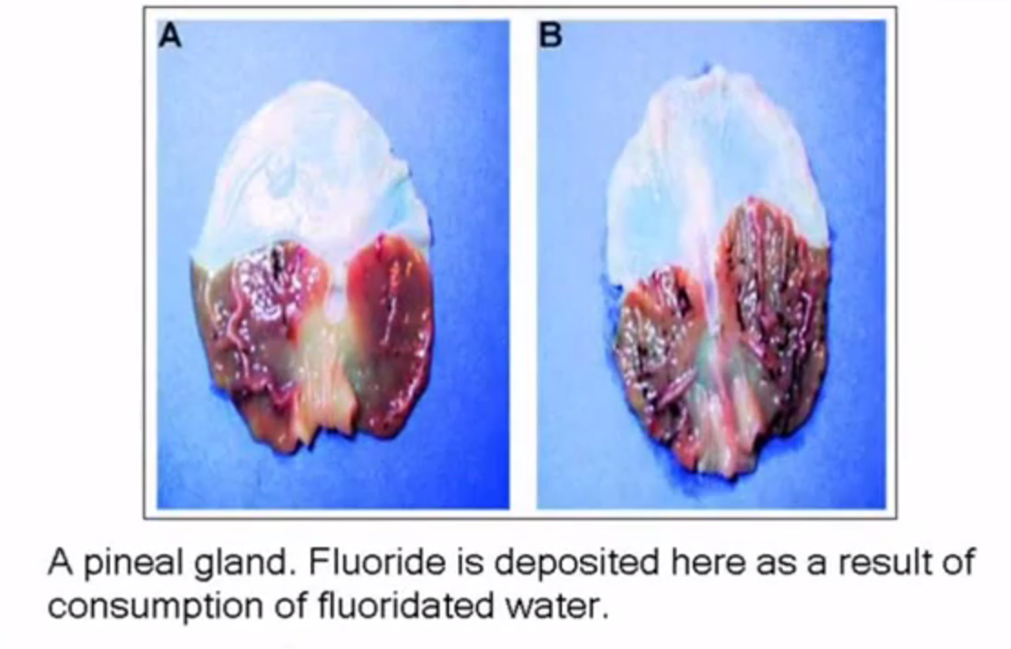
Fluoride Pineal Gland

Slide 30
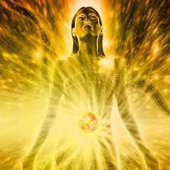
Soul/Spirit Healing
Soul Fragments
  Healing/Cleaning them
What the Soul looks like healed
What will it feel like
The Soul Healing Process

Slide 31
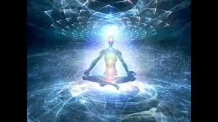
Physical Body Healing
The Process
  Removing everything: Infections, Diseases, Toxins, Poisons, Cancers, Unwanted/Unnecessary Bacteria, Lower Vibrational Energies/Emotions
  Healing everything: Bones, tissues, organs, muscles, tendons, veins, hair, nails and all cells in the body
  Balance everything: Hormones, serotonin, endorphins, Female/Male, etc.
Send it all to God/Source and Know that the body is healed and whole
Zipping Up Process
  Using the Healing Seeds & Buttons

Slide 32
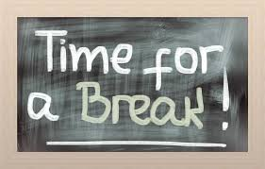
Break time
5 minutes,
Please Turn Off your Phones

Slide 33
Meditation
Heart Center Ball of Light, Inside the Heart
  Un-ground yourself, pull it up
Removing the Earth/Psychic Cord
Going up through the Crown, pulling back the film and pushing up through the Silver Cord
Traveling to Heaven/Source
  In God/Source – Run Healing Program
Descend and put the caps/blocks back on
Ground & pull up Earth Energy

Slide 34
Journaling
Like Us and Please share your experience on:
Class #3 Overview, Ascending to Enlightenment – Dropping the Illusion
To get this presentation:
  www.PaladinicHealing.com
    Click on the Class Material

Slide 35
